Slide 1
Overview of CISN Operations and Products
David Oppenheimer
USGS
Menlo Park, CA

Slide 2
What is the CISN?
The California Integrated Seismic Network is a collaborative effort, founded in 2000, to integrate existing, separate California earthquake monitoring networks into a single seismic monitoring system.
The CISN provides the organizational framework to coordinate these earthquake-monitoring operations.
The CISN constitutes the California region within Advanced National Seismic System (ANSS).

Slide 3
Who is the CISN?
Core members have primary responsibility for the recording and monitoring of earthquakes and the creation of CISN products
California Geological Survey
U.C. Berkeley Seismological Laboratory
Caltech Seismological Laboratory
Menlo Park USGS
Pasadena USGS
USGS National Strong Motion Project
Managed through the PMG

Slide 4
Who is the CISN?
Participating members contribute to CISN activities through data exchange.
UC Santa Barbara
UC San Diego
University of Nevada Reno
CA Department of Water Resources
CICESE
Lawrence Berkeley National Labs/Calpine
PG&E
US Array/TA
University of Washington

Slide 5
CISN Goals
Operate a reliable and robust statewide system to record earthquake ground motions over the relevant range of frequencies and shaking levels
Distribute information about earthquakes rapidly after their occurrence for emergency response and public information
Create an easily accessible archive of California earthquake data for engineering and seismological research, including waveform data and derived products

Slide 6
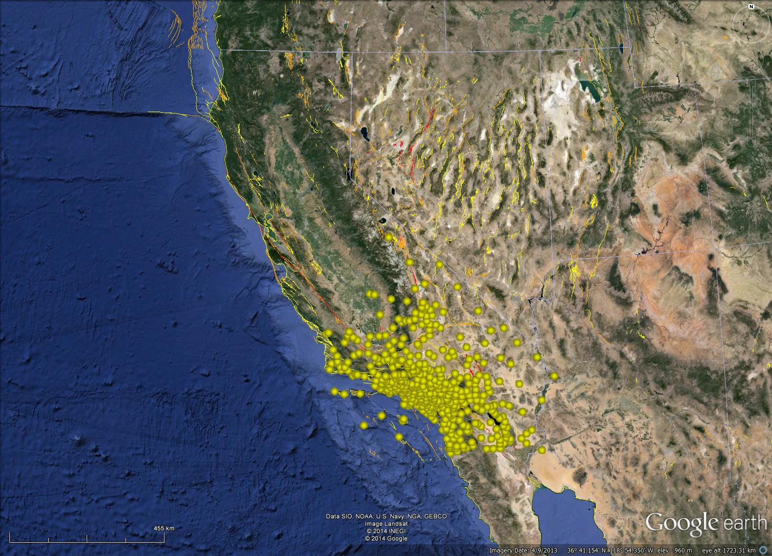
Caltech/USGS (CI) - 417

Slide 7
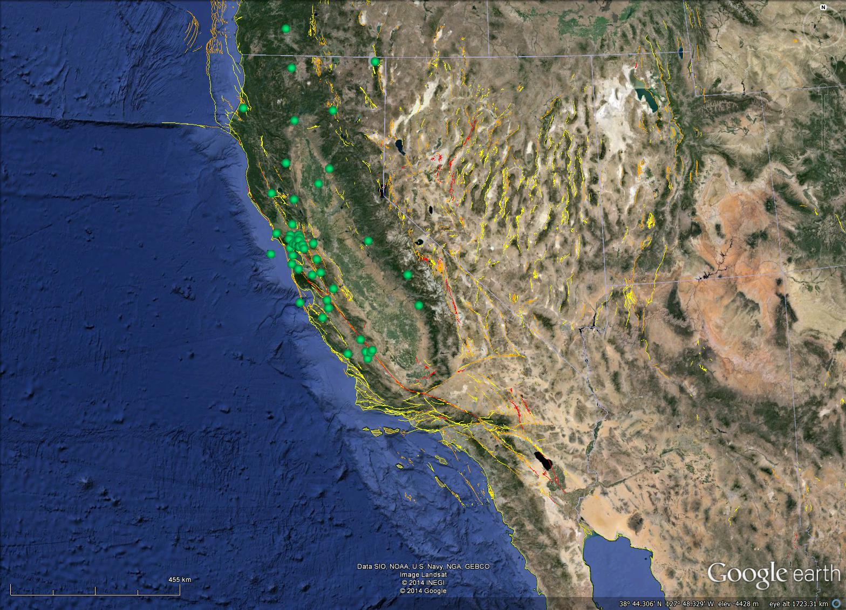
UC Berkeley (BK) - 50

Slide 8
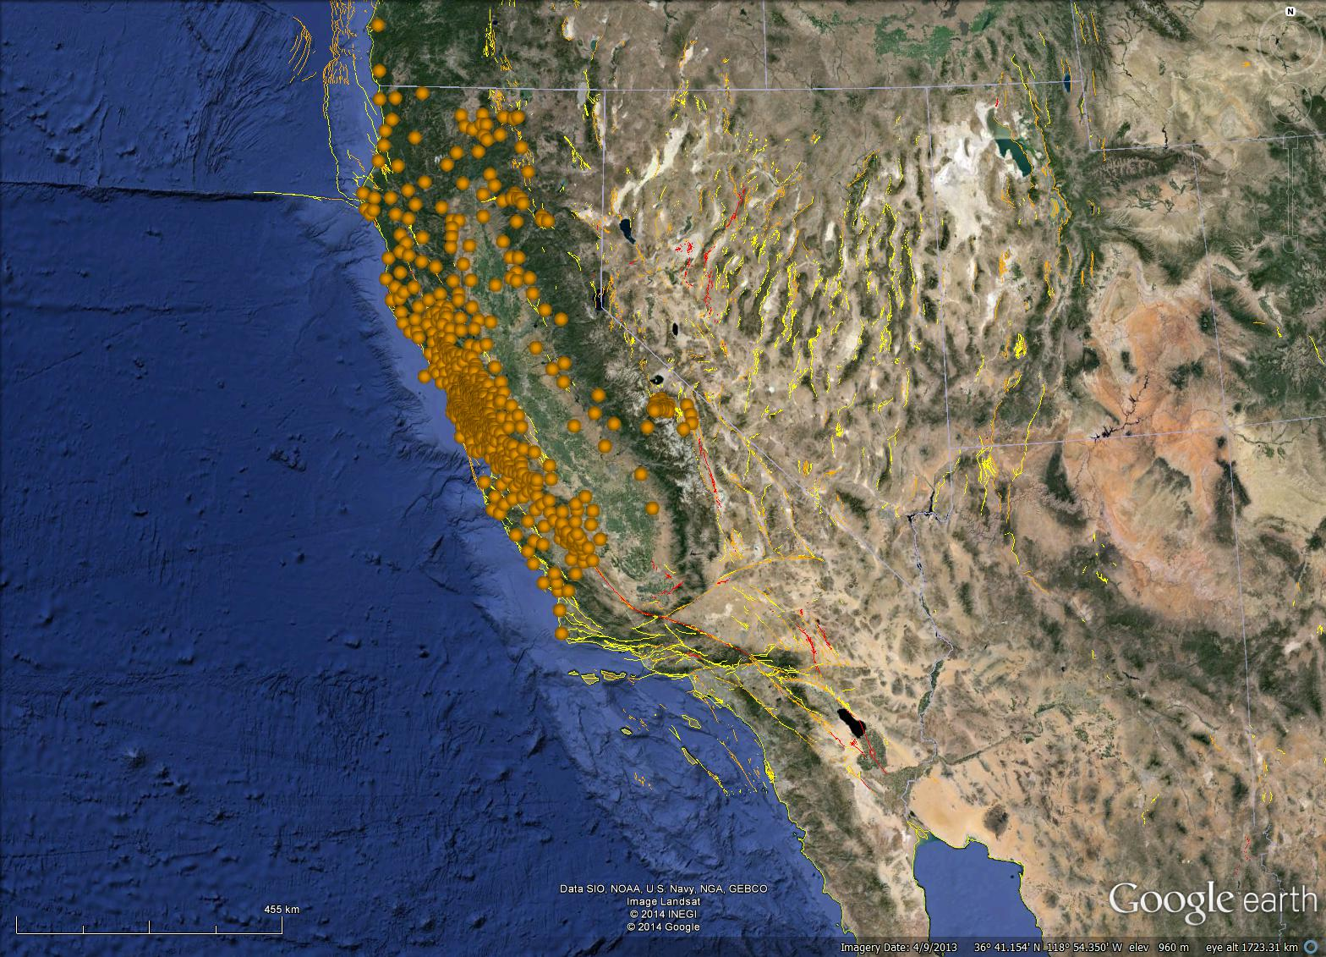
USGS NCSN (NC) - 519

Slide 9
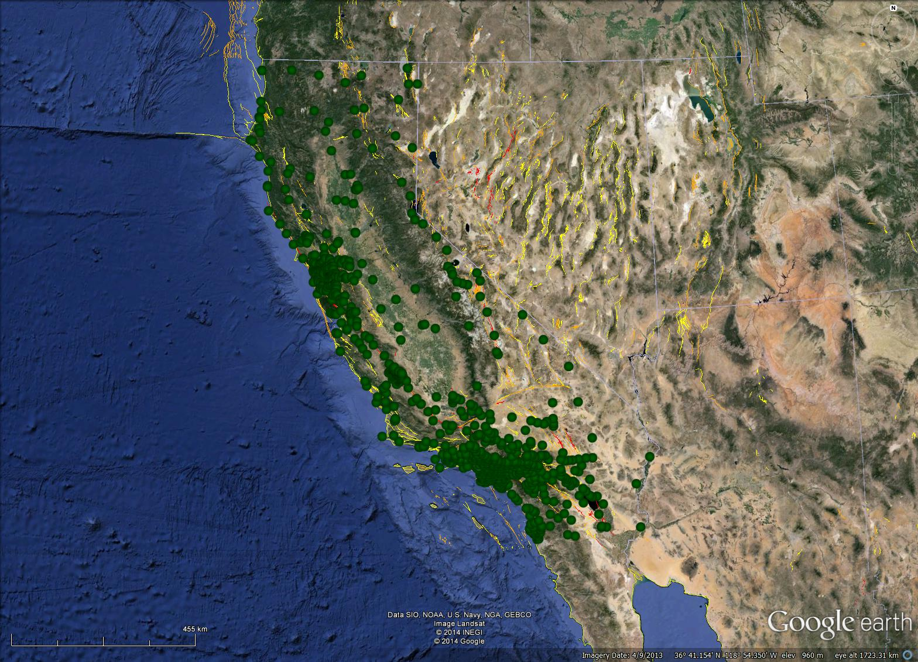
CGS (CE) - 864

Slide 10
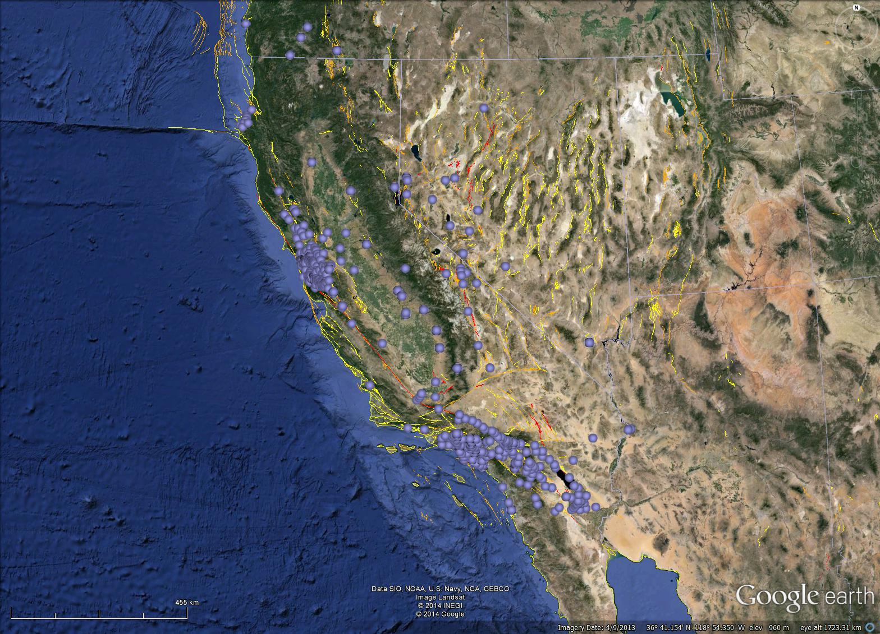
USGS NSMP (NP) - 414

Slide 11
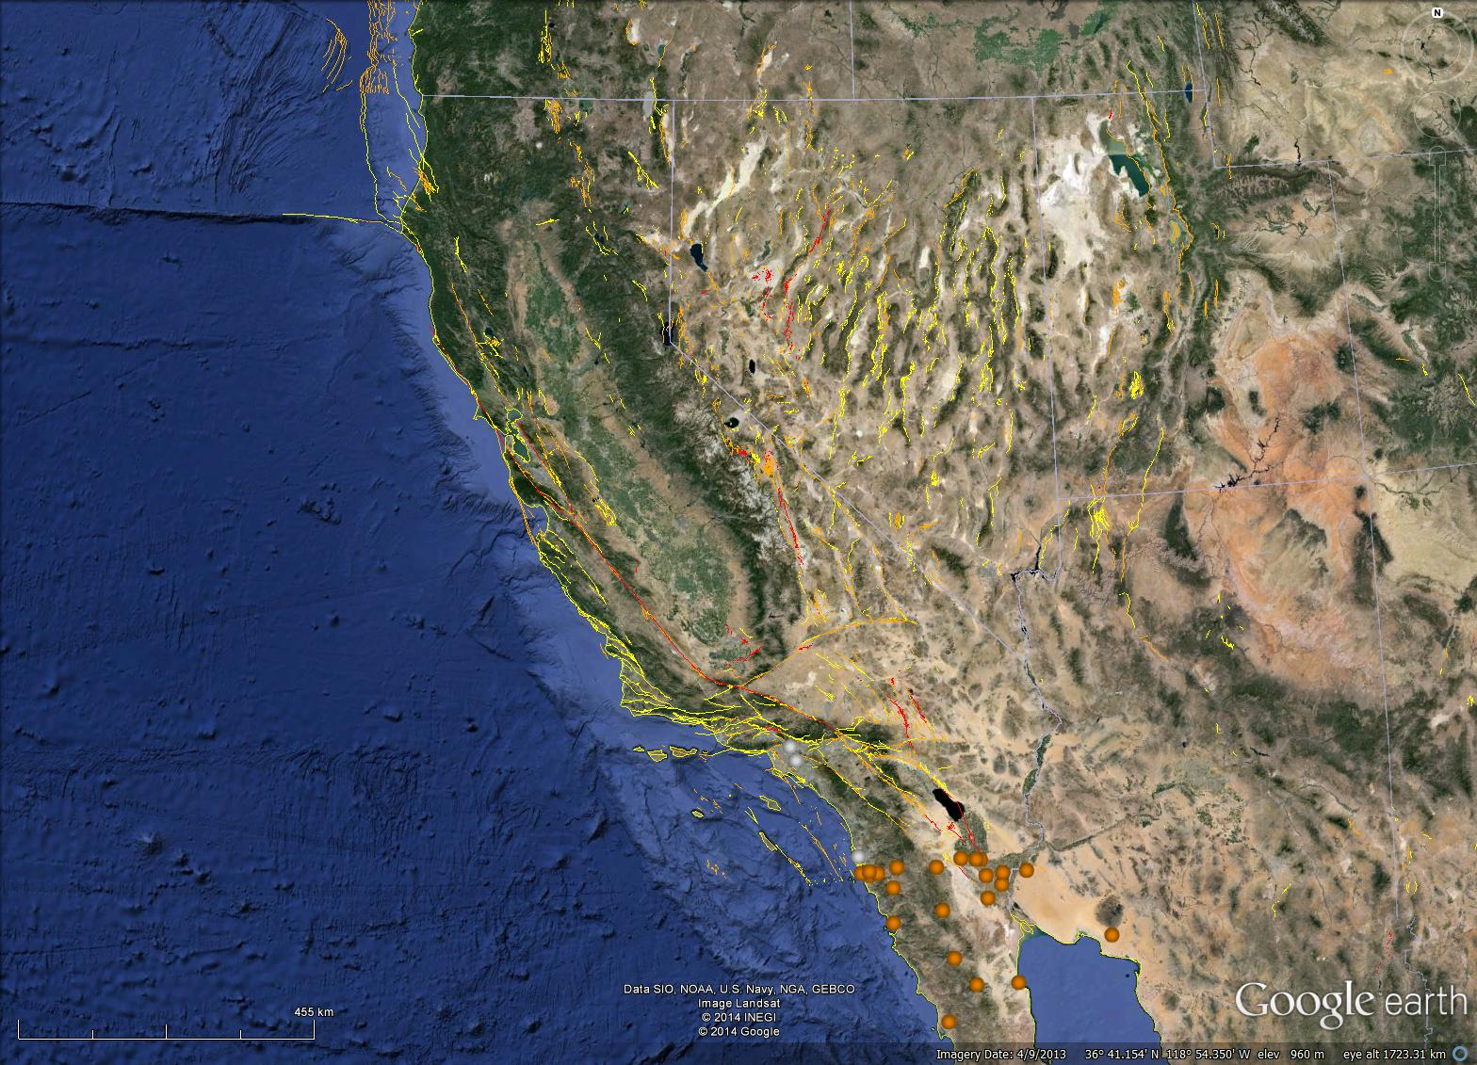
CICESE (BC) - 23

Slide 12
UCSD Anza (AZ) - 29

Slide 13
CA DWR (WR) - 15

Slide 14
PG&E (PG) - 29

Slide 15
UNR (NN) - 72

Slide 16
LBL/Calpine (BG) - 32

Slide 17
US Array (TA) - 8

Slide 18
UW (UW) - 4

Slide 19
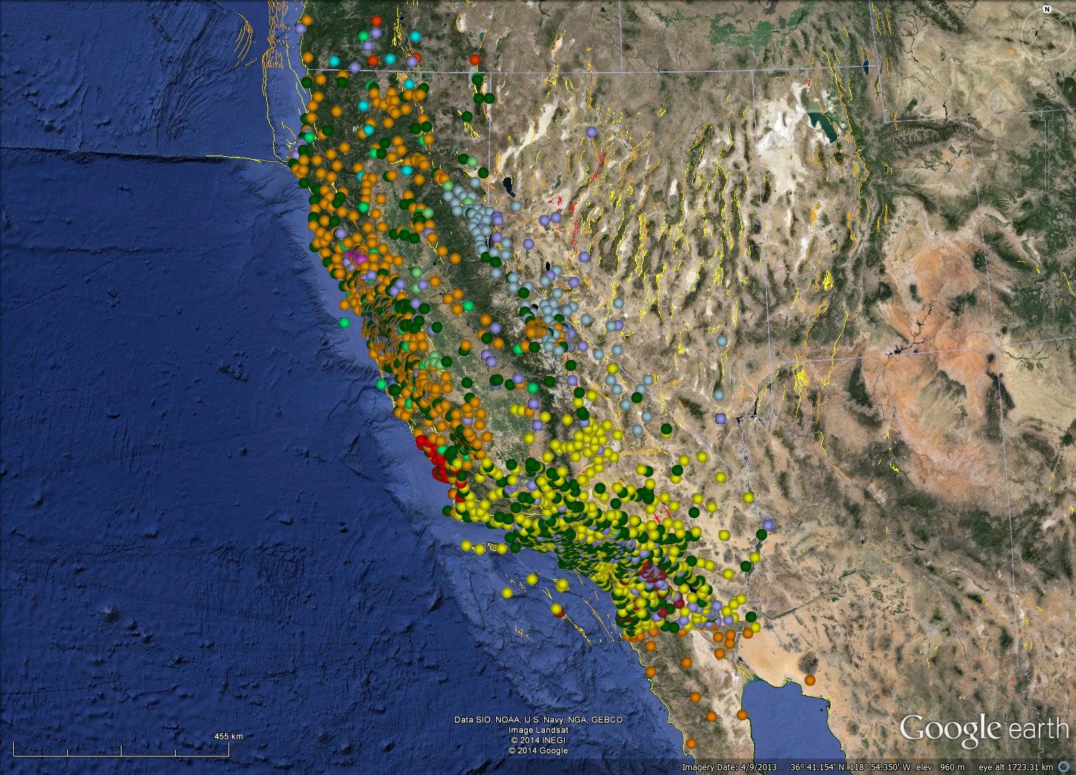
Total – 2475
(available via KML)

Slide 20
Products
Earthquake reporting and review
Locations
Magnitudes
Moment tensors
First-motion mechanisms
ShakeMaps
COSMOS V0-V3
Aftershock probabilities
Double Difference locations
CISN Display
Software
AQMS
Earthworm
Metadata management
EEW
NetQuakes/NetWorm
Archiving
Event and Continuous waveforms
Earthquake catalog
COSMOS products

Slide 21
http://strongmotioncenter.org/

Slide 22
http://www.ncedc.org/

Slide 23
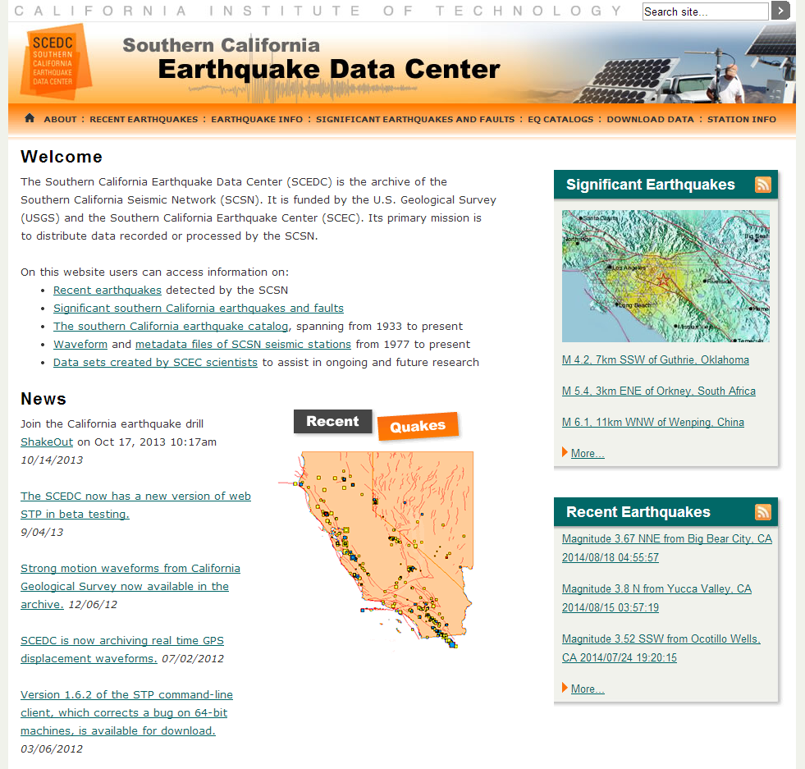
http://www.data.scec.org/

Slide 24
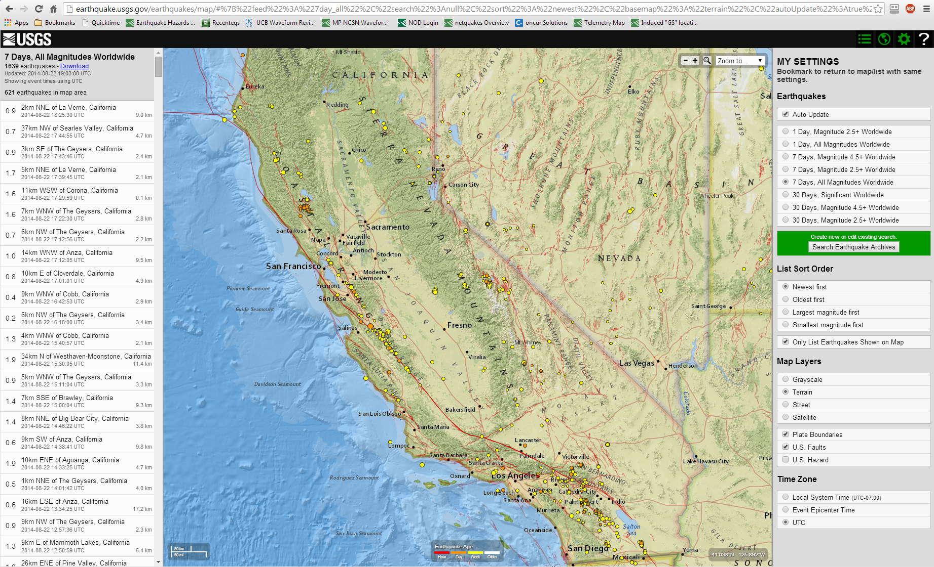
http://earthquake.usgs.gov/earthquakes/map/

Slide 25
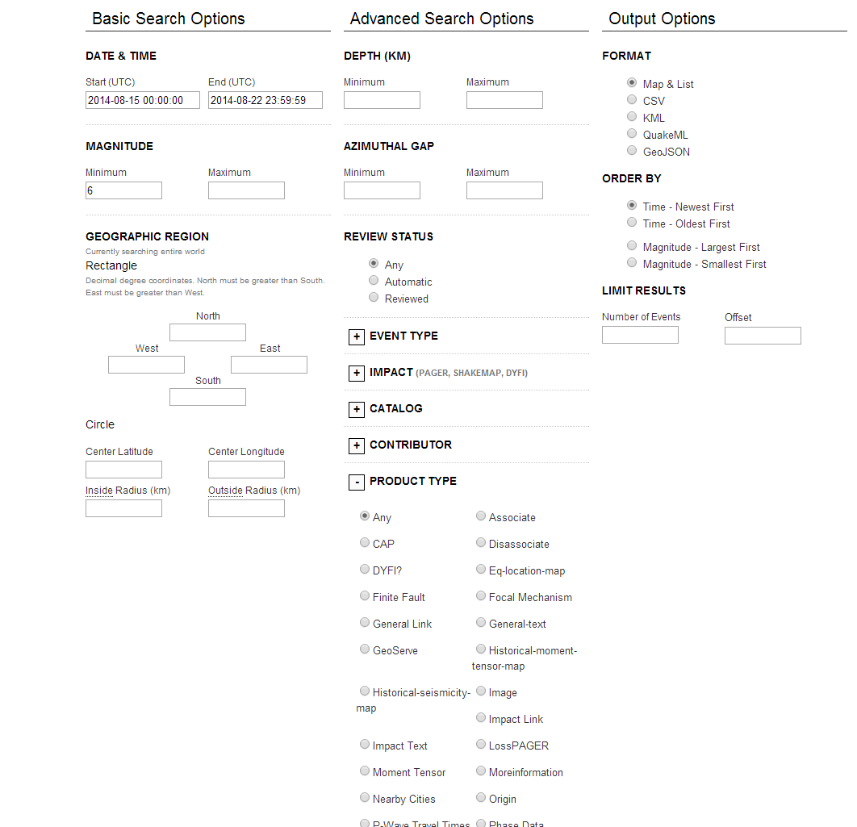
ComCat

